Slide 1
Factors of College Dropout
Mikaela Olaya, Sara Gassew, Hailey York, Jeff Sreca, and Alec Carpenter

Slide 2
INTRODUCTION
Data mining can play a crucial role in identifying the factors that contribute to student dropout rates and devising effective strategies to address them in a timely manner
By analyzing a variety of data sources such as student demographics, academic performance, unemployment rate, and social and economic factors, data mining can uncover patterns and correlations that can help predict which students are at the highest risk of dropping out
The increase in students dropping out of school has been a long-standing concern in education.
Information can be used to develop a multitude of help and outreach programs for these students, such as tutoring, counseling, or financial assistance.
Notes:
Mikaela

Slide 3
BACKGROUND
Various data mining methods have previously been used to gain insight on the topic of student academic performance and dropout rates
Logistic regressions, clustering, neural networks, and deep learning algorithms have all been used previously
Decision tree models are the most commonly used and have some of the highest accuracy scores
When using a decision tree model, we must keep in mind that the variables we decide to include will greatly affect the overall accuracy of the model
If model accuracy is too low, we will instead use a random forest model

Slide 4
PROBLEM STATEMENT
College dropout rates are an everlasting problem with a large portion of college dropouts
This is a problem on a large scale because a large portion of college dropouts impact the overall economy with the increasing amounts of debt accrued that they are less likely to be able to repay due to their higher rates of unemployment.
One of the largest challenges the world faces due to college dropouts is a lack of skill to enter the workforce
An increase in college graduates will benefit the economy and society as a whole as it has the potential to decrease poverty and unemployment which are also large scale issues
Notes:
Sara

Slide 5
BUSINESS GOAL
Our data set provides the insight of students that are enrolled in undergraduate degree programs within higher education institutions.
Our goal is to determine what factors most likely influenced these former students to drop out.
Using this data we can determine student performance by the end of each semester using variables like enrolled and credited and their grades earned.
We use variables like unemployment rate, GDP, and inflation rate per demographic that will help us determine the economic influence on student drop out
We aim to be able to establish which of these factors have the largest impact so that programs can be put in place across universities in order to prevent college dropouts through additional financial or academic assistance.
Notes:
Sara

Slide 6
DATA PROFILE
The original dataset comprised 35 variables and 4424 records with no missing variables. Upon further inspection of the dataset, it was determined that we would take out eight variables.
We changed the target variable to binary keeping only graduate and dropout records.
If a record contained the word “dropout” it would receive a 1 and if it contained “graduate” it would receive a 0. This altered our dataset by decreasing the number of records from 4424 to 3631.

Slide 7
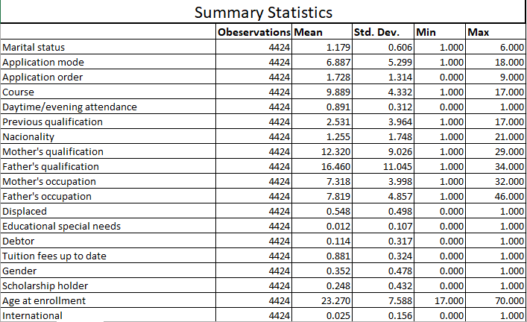
DATA

Slide 8
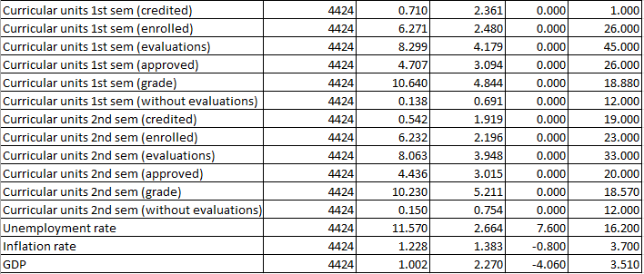
DATA

Slide 9
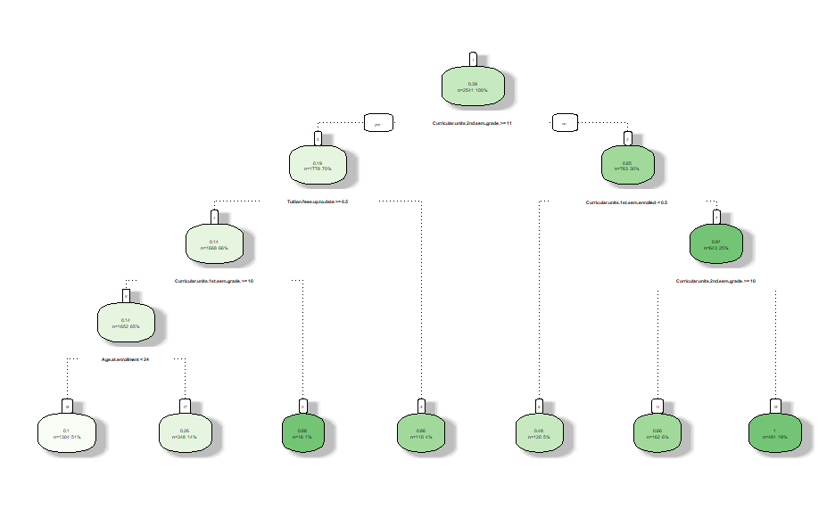
DECISION TREE

Slide 10
METHOD
1
2
3
4
5
8 variables removed
Changed Target variable to Binary
Decided on Decision Tree Analysis
Determined a Random Forest was best
Ntree of 100 found to have highest accuracy

Slide 11
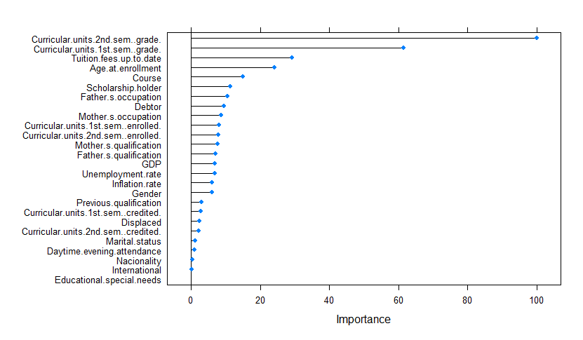
RESULTS
The random forest model with 100 iterations had the highest accuracy. The accuracy of our final model was 87.88%.
The variable that has the greatest impact on students is their second semester grade, followed by their first semester grade and then whether their tuition fees are up to date.

Slide 12
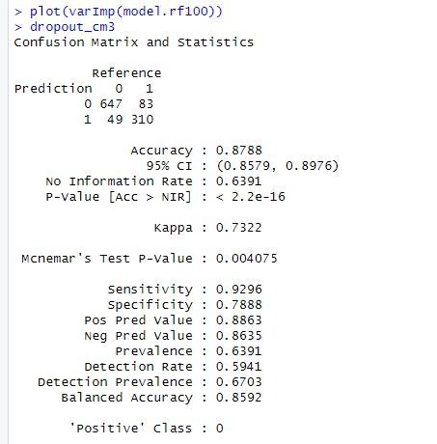
RESULTS
The random forest model had a total of 310 true positives and 647 true negatives reported, with 49 false positives and 83 false negatives.
The reported sensitivity is 92.96% and a specificity of 78.88%.

Slide 13
RESULTS
According to the the analysis we have determined that to improve one's likelihood to graduate the main focus should be on your academic performance.
Other socioeconomic and demographic variables had much less of an impact than expected. For example, Educational.special.needs and International did not play any role to students dropping out of school, showing that the international students and students with disabilities are being accommodated properly to treat their needs, guiding them to graduation.

Slide 14
CONCLUSION
College is undoubtedly one of the most challenging and complex times in someone's life.
Using decision trees, specifically random forests, we were not only able to pinpoint what variables influence someone's decision to drop out of college but also see the possible combinations of factors that lead to a drop out outcome.
Notes:
Mikaela

Slide 15
THANK YOU
ANY QUESTIONS?
Notes:
Sara

